Slide 1

AULA 2.3
CÁLCULO DO ÂNGULO

Slide 2
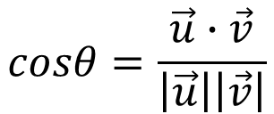

Cálculo do ângulo
$$cosθ=\frac{\vec{u}∙\vec{v}}{\left|\vec{u}\right|\left|\vec{v}\right|}$$
Se
$$\vec{u}∙\vec{v}=\left|\vec{u}\right|\left|\vec{v}\right|cosθ$$
Então

Slide 3
Cálculo do ângulo

Slide 5
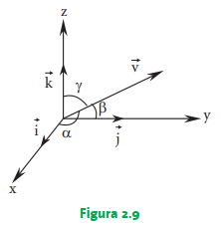

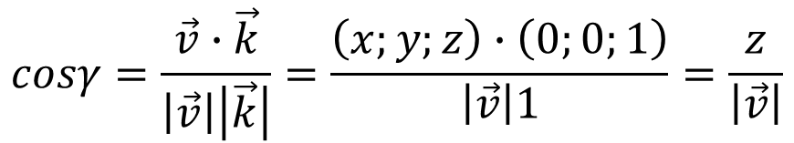
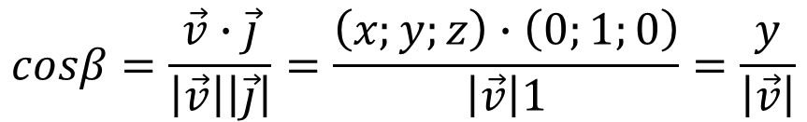
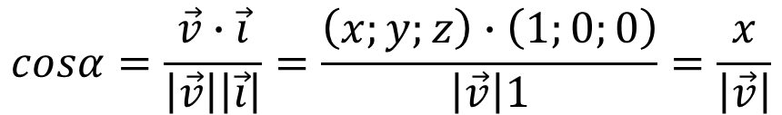

Ângulos diretores
$$cosα=\frac{\vec{v}∙\vec{i}}{\left|\vec{v}\right|\left|\vec{i}\right|}=\frac{\left(x;y;z\right)∙\left(1;0;0\right)}{\left|\vec{v}\right|1}=\frac{x}{\left|\vec{v}\right|}$$
$$cosβ=\frac{\vec{v}∙\vec{j}}{\left|\vec{v}\right|\left|\vec{j}\right|}=\frac{\left(x;y;z\right)∙\left(0;1;0\right)}{\left|\vec{v}\right|1}=\frac{y}{\left|\vec{v}\right|}$$
$$cosγ=\frac{\vec{v}∙\vec{k}}{\left|\vec{v}\right|\left|\vec{k}\right|}=\frac{\left(x;y;z\right)∙\left(0;0;1\right)}{\left|\vec{v}\right|1}=\frac{z}{\left|\vec{v}\right|}$$
$$\vec{v}$$
$\frac{\vec{v}}{\left|\vec{v}\right|}=\frac{\left(x;y;z\right)}{\left|\vec{v}\right|}=\frac{\left(x\right)}{\left|\vec{v}\right|}$ $;\frac{\left(y\right)}{\left|\vec{v}\right|}$ $;\frac{\left(z\right)}{\left|\vec{v}\right|}=cosα;cosβ;cosγ$
Seja o versor de
Por ser unitário, temos que
$$\cos^{2}α+\cos^{2}β+\cos^{2}γ=1$$

